Slide 1
The Limits to Growth: Sustainability and the Circular Economy
Lecture 4: Limits to Growth and Planetary Boundaries
Prof. Dr. Benjamin Leiding
M.Sc. Anant Sujatanagarjuna
M.Sc. Chintan Patel

Slide 2
License
This work is licensed under a Creative Commons Attribution-ShareAlike 4.0 International License. To view a copy of this license, please refer to https://creativecommons.org/licenses/by-sa/4.0/ .
Updated versions of these slides will be available in our Github repository.

Slide 3
Introduction

Slide 4
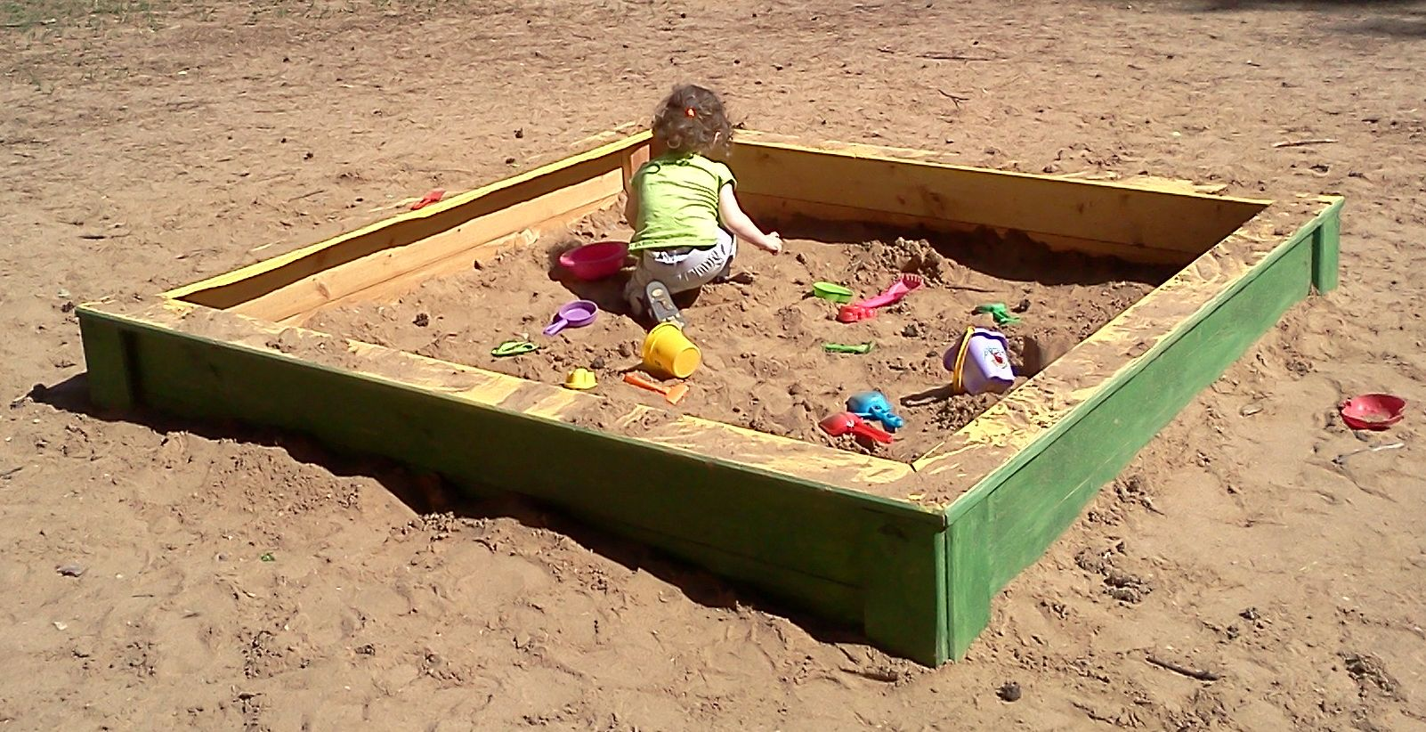
Introduction
Finite Systems – Sandbox / Playground
Al Silonov – https://commons.wikimedia.org/wiki/File:Sandbox-2013.jpg – CC BY-SA 4.0.

Slide 5
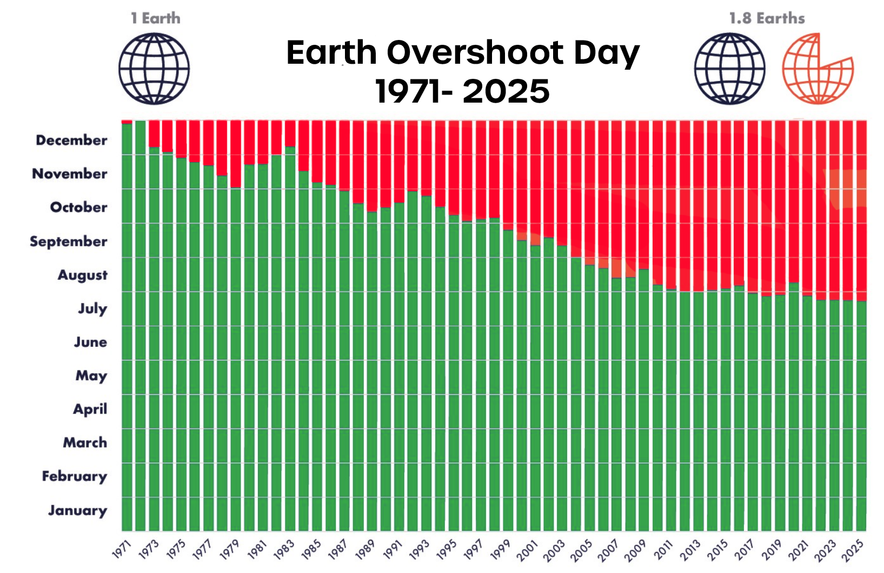
Introduction
Earth Overshoot Day
Figure adapted from https://www.overshootday.org/newsroom/past-earth-overshoot-days/

Slide 6
Introduction
Lotka–Volterra Equations (Predator–Prey Equations)

Slide 7
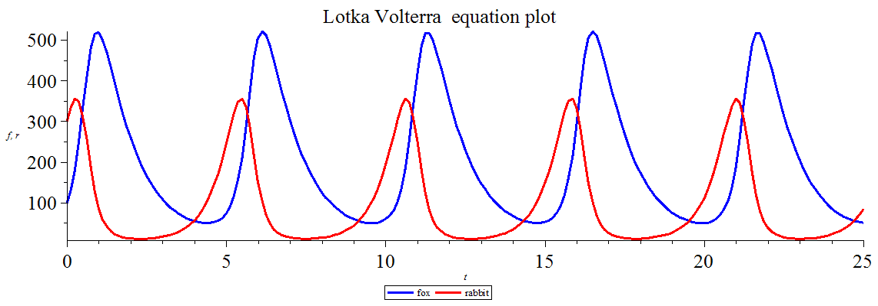
Introduction
Lotka–Volterra Equations (Predator–Prey Equations)
Gisling – https://commons.wikimedia.org/wiki/File:Lotka_Volterra_equation_Maple_plot.png – CC BY-SA 3.0.

Slide 8

Introduction
The Limits to Growth – 1972

Slide 9
Introduction
The Limits to Growth
“If the present growth trends in world population, industrialization, pollution, food production, and resource depletion continue unchanged, the limits to growth on this planet will be reached sometime within the next one hundred years.
The most probable result will be a rather sudden and uncontrollable decline in both population and industrial capacity.”
Meadows (1972) – The Limits to Growth

Slide 10
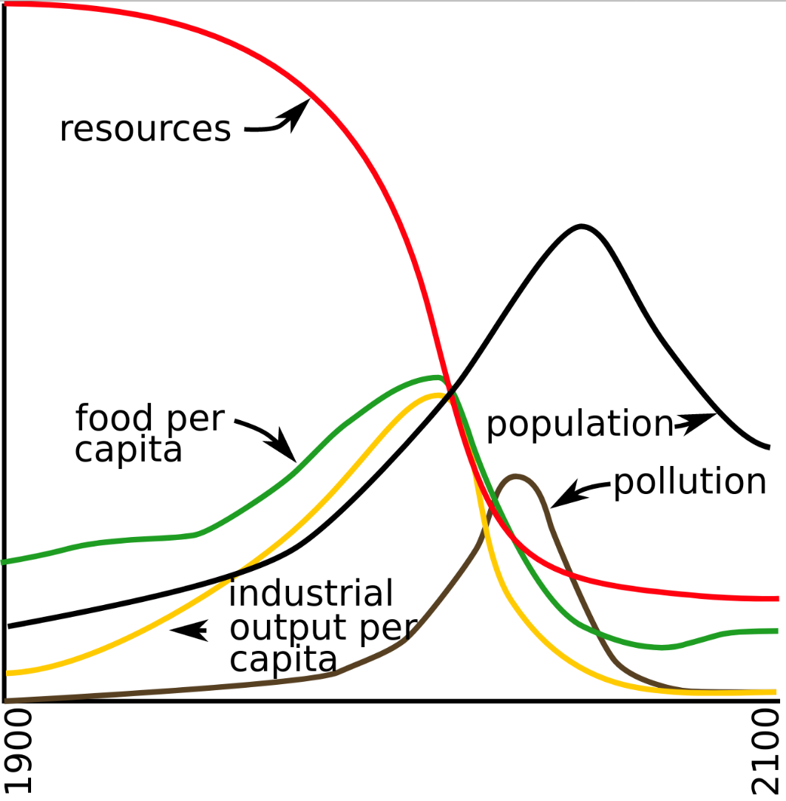
Introduction
The Limits to Growth – World3 Standard Run
Reconstruction by YaguraStation of Figure 35. page 124 of The Limits to Growth (1972) is licensed with CC BY-SA 4.0. To view a copy of this license, visit https://creativecommons.org/licenses/by-sa/4.0/

Slide 11
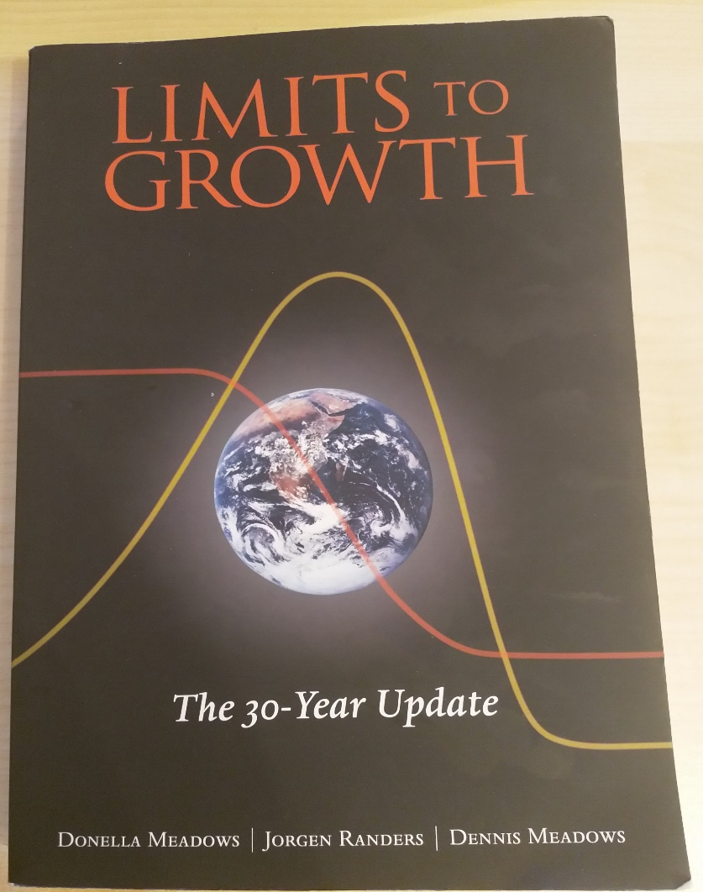
Introduction
The Limits to Growth – 1972 / 2004

Slide 12
Introduction
The Limits to Growth – World3 Model
Click Me
Click Me

Slide 13
Planetary Boundaries

Slide 14
Planetary Boundaries
Concept
First proposed by researchers led by Johan Rockström from the Stockholm Resilience Centre in 2009
Quantitative planetary boundaries within which future generations can continue to exist
Based on nine indicators that are of high importance for the stability and resilience of the Earth system
Crossing these boundaries increases uncertainties about humanity's future and the risk of severe or irreversible environmental changes

Slide 15
Planetary Boundaries
Concept
First proposed by researchers led by Johan Rockström from the Stockholm Resilience Centre in 2009
Quantitative planetary boundaries within which future generations can continue to exist
Based on nine indicators that are of high importance for the stability and resilience of the Earth system
Crossing these boundaries increases uncertainties about humanity's future and the risk of severe or irreversible environmental changes

Slide 16
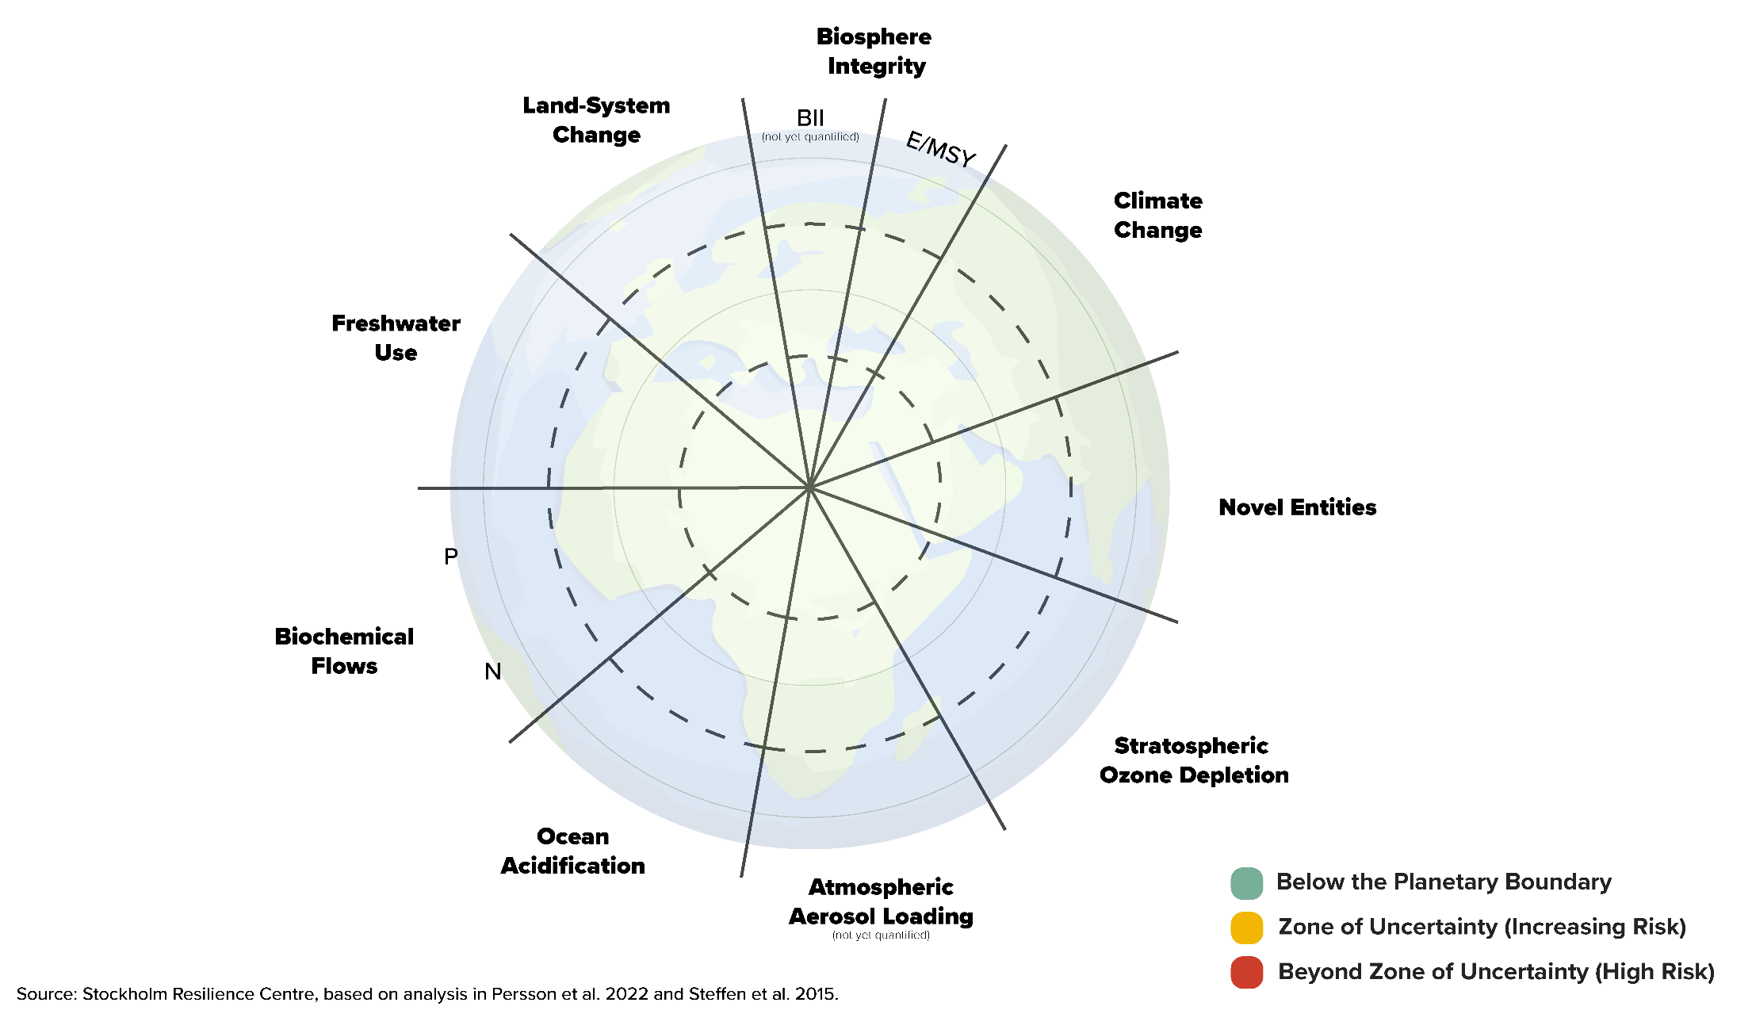
Planetary Boundaries
Concept

Slide 17
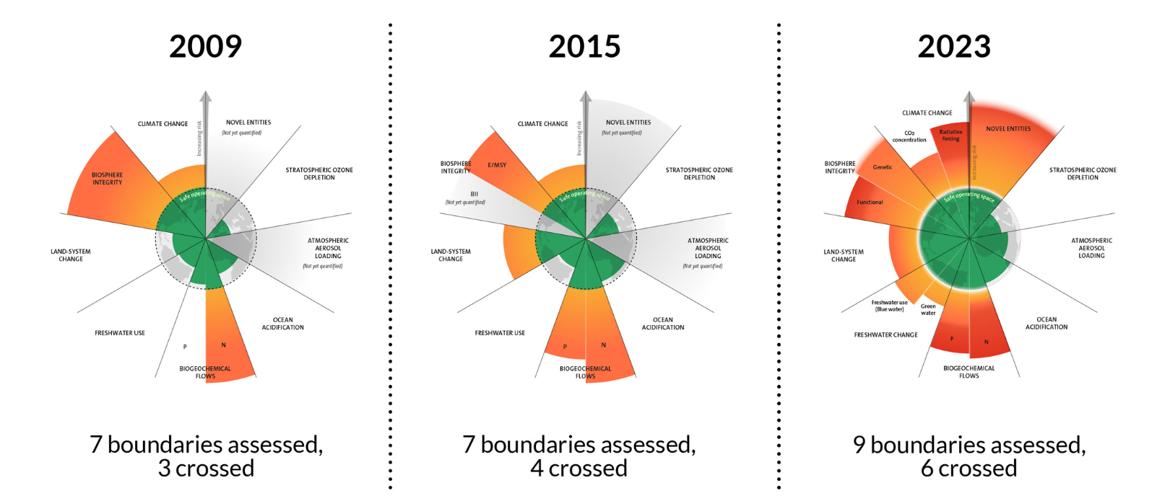
Planetary Boundaries
The evolution of the planetary boundaries framework. Licenced under CC BY-NC-ND 3.0 (Credit: Azote for Stockholm Resilience Centre, Stockholm University. Based on Richardson et al. 2023, Steffen et al. 2015, and Rockström et al. 2009)

Slide 18
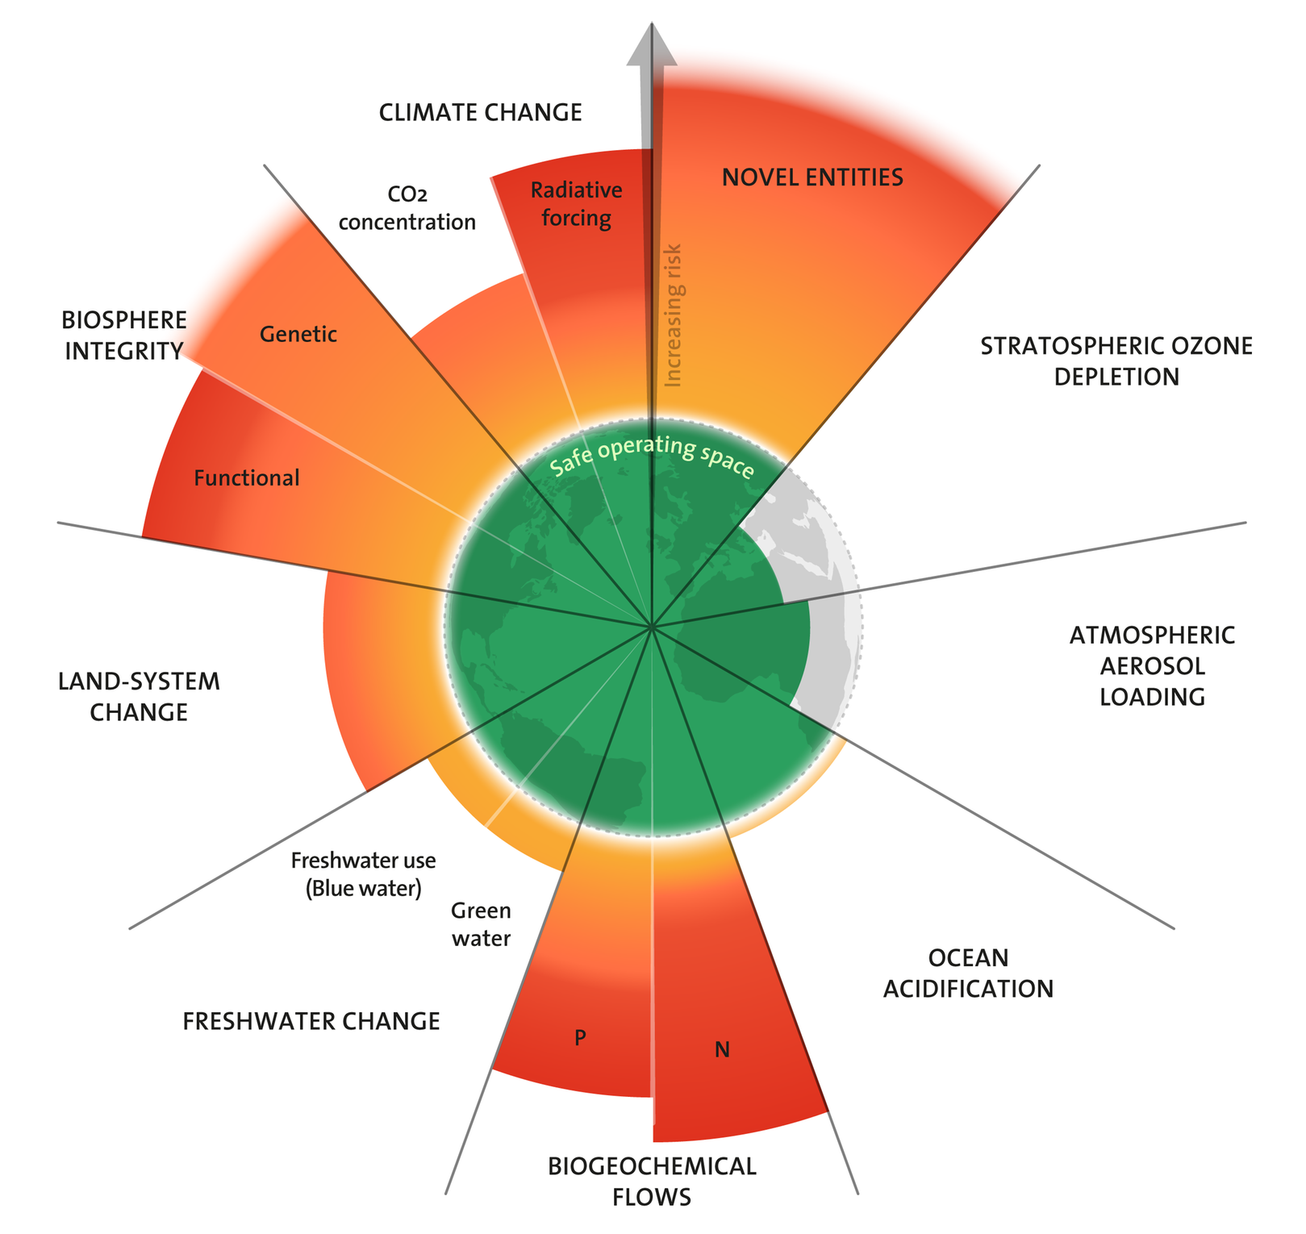
Planetary Boundaries
2025
All boundaries are finally assessed
Seven boundaries are now transgressed and pressure is increasing on all boundary processes → only exeption is the ozone depletion and aerosol loading
Azote for Stockholm Resilience Centre, based on analysis in Richardson et al 2025 – CC BY-NC-ND 3.0.

Slide 19
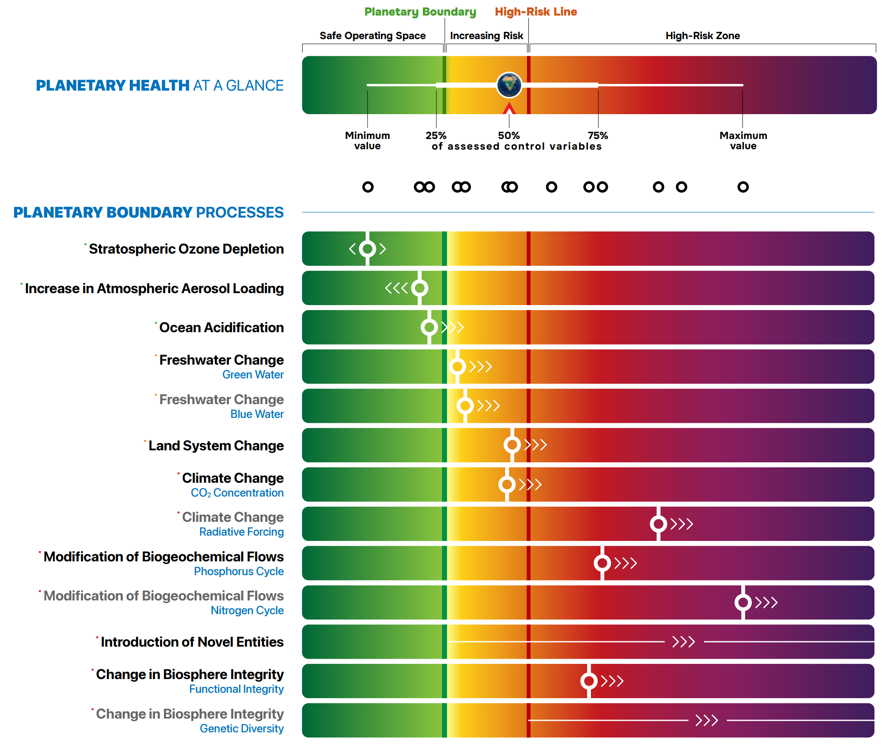
Planetary Boundaries
2024
L. Caesar*, B. Sakschewski*, L. S. Andersen, T. Beringer, J. Braun, D.
Dennis, D. Gerten, A. Heilemann, J. Kaiser, N.H. Kitzmann, S. Loriani, W. Lucht, J. Ludescher, M. Martin, S. Mathesius, A. Paolucci, S. te Wierik, J. Rockström, 2024, Planetary Health Check Report 2024. Potsdam Institute for Climate Impact Research, Potsdam, Germany – CC BY 4.0.

Slide 20
World3 Model

Slide 21
World3
History – System Dynamics
Developed in the 1960s at MIT by Jay Forrester
Methodology and mathematical modeling technique
Used to understand the nonlinear behaviour of complex systems over time
→ e.g., Forrester created a model called World2

Slide 22
World3
History – System Dynamics
System Dynamics modeling starts with defining levels (stocks) and their rates (flows)
“Laundry lists” specify the set of influencing factors for each of the rate variables
Levels:
Population (Inflows: Birth rate | Outflows: Death rate)
Money (Inflows: Income | Outflows: Expenses)
Laundry list for “Birth rate”:
Population
Standard of living
Food Quality
Food Quantity
Education
Contraceptives
F. E. Cellier (2008) – World3 in Modelica: Creating System Dynamics Models in the Modelica Framework – Link

Slide 23
World3
History – System Dynamics
System Dynamics modeling starts with defining levels (stocks) and their rates (flows)
“Laundry lists” specify the set of influencing factors for each of the rate variables
Levels:
Population (Inflows: Birth rate | Outflows: Death rate)
Money (Inflows: Income | Outflows: Expenses)
Laundry list for “Birth rate”:
Population
Standard of living
Food Quality
Food Quantity
Education
Contraceptives
F. E. Cellier (2008) – World3 in Modelica: Creating System Dynamics Models in the Modelica Framework – Link

Slide 24
World3
History – System Dynamics
System Dynamics modeling starts with defining levels (stocks) and their rates (flows)
“Laundry lists” specify the set of influencing factors for each of the rate variables
Levels:
Population (Inflows: Birth rate | Outflows: Death rate)
Money (Inflows: Income | Outflows: Expenses)
Laundry list for “Birth rate”:
Population
Standard of living
Food Quality
Food Quantity
Education
Contraceptives
F. E. Cellier (2008) – World3 in Modelica: Creating System Dynamics Models in the Modelica Framework – Link

Slide 25
World3
History – World2 to World3
The Club of Rome (non-governmental organization – NGO) invites Forrester to apply his ideas to the global economy and ecosystem → declines and proceeds with the project without the Club of Rome.
Dennis Meadows (colleague and former student of Forrester) organizes the project for The Club of Rome.
17 researchers spend a year refining and enlarging the Forrester World2 model → World3.
World3 is considerably more complex and more powerful
Brian Hayes (2012) – Computation and the Human Condition (Harvard SEAS) – Link

Slide 26
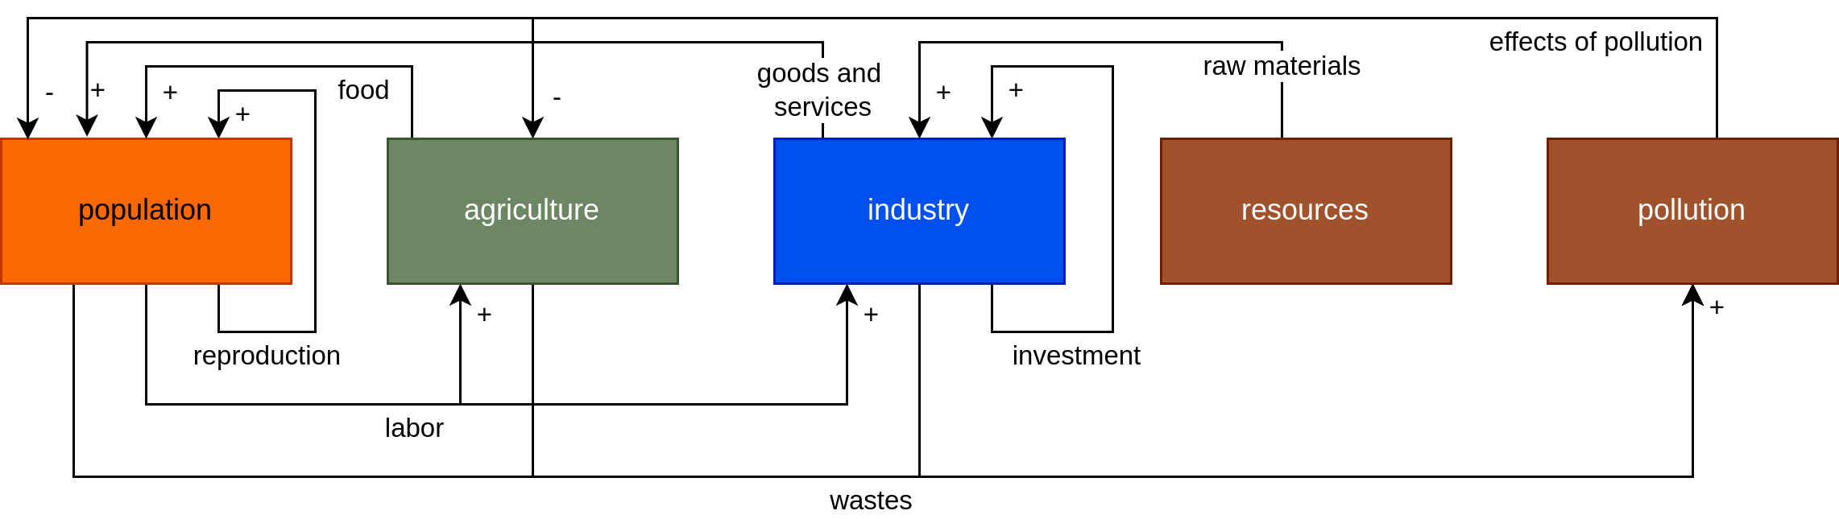
World3
Model Components
Image recreated from: Brian Hayes (2012) – Computation and the Human Predicament – Link

Slide 27
World3
Overview
ca. 150 equations that govern the model
5 main sectors
Population
Agriculture
Industry
Resources
Pollution
Covers the period from 1900 to 2100
Written in a language called DYNAMO

Slide 28
World3
Population
People
Control mechanisms:
Birth rates
Death rates
Maturation → carrying people from one age category to the next

Slide 29
World3
Agriculture
Arable land
Control mechanisms:
Cultivation of new land
Farmland lost due to, e.g., erosion and urban development

Slide 30
World3
Industry
Capital (in USD) representing factories or other productive facilities
Control mechanisms:
Investment input / inflow
Investment outflow / deprecation

Slide 31
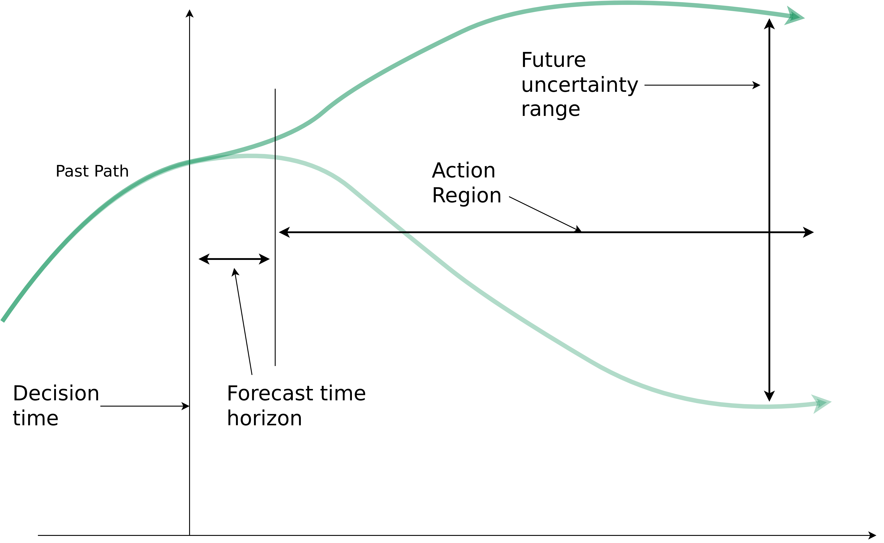
World3
Forrester’s Dilemma
“One can forecast future conditions in the region where action is not effective, and one can have influence in the region where forecasting is not reliable.” – Forrester, 2007
Image recreated from: Brian Hayes (2012) – Computation and the Human Condition (Harvard SEAS) – Link

Slide 32
World3
Simulation Results
Various scenarios based on different assumptions
4 popular scenarios:
Business-as-usual (BAU)
Business-as-usual2 (BAU2) → double the natural resources of BAU
Comprehensive Technology (CT) → BAU2 + exceptionally high technological development and adoption rates
Stabilized Wolrd (SW) → CT + changes in societal values and priorities

Slide 33
World3
Simulation Results
Various scenarios based on different assumptions
4 popular scenarios:
Business-as-usual (BAU)
Business-as-usual2 (BAU2) → double the natural resources of BAU
Comprehensive Technology (CT) → BAU2 + exceptionally high technological development and adoption rates
Stabilized Wolrd (SW) → CT + changes in societal values and priorities

Slide 34
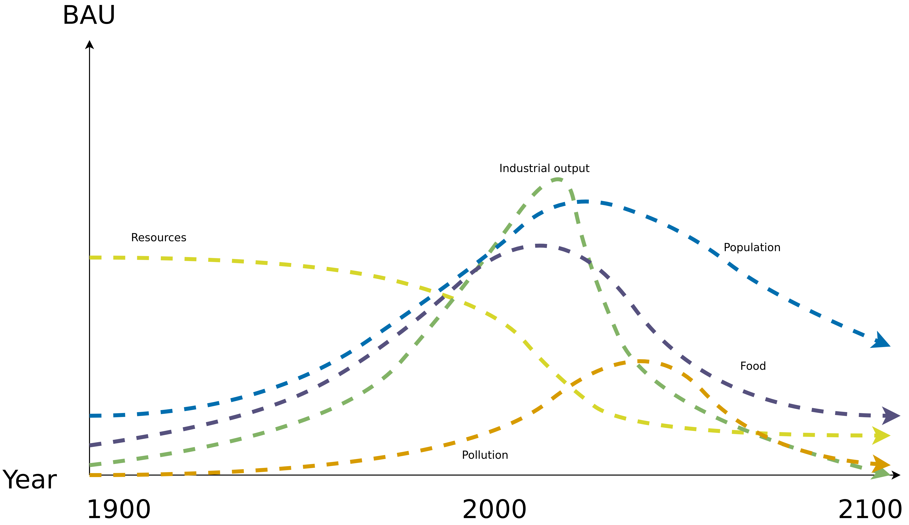
World3
Standard Run – Business-as-Usual (BAU)
Image recreated from: Gaya Herrington (2020) – Update to limits to growth: Comparing the World3 model with empirical data – Link

Slide 35
World3
Standard Run – Business-as-Usual (BAU)
→ Collapse due to natural resource depletion
Image recreated from: Gaya Herrington (2020) – Update to limits to growth: Comparing the World3 model with empirical data – Link

Slide 36
World3
Simulation Results
Various scenarios based on different assumptions
4 popular scenarios:
Business-as-usual (BAU)
Business-as-usual2 (BAU2) → double the natural resources of BAU
Comprehensive Technology (CT) → BAU2 + exceptionally high technological development and adoption rates
Stabilized Wolrd (SW) → CT + changes in societal values and priorities

Slide 37
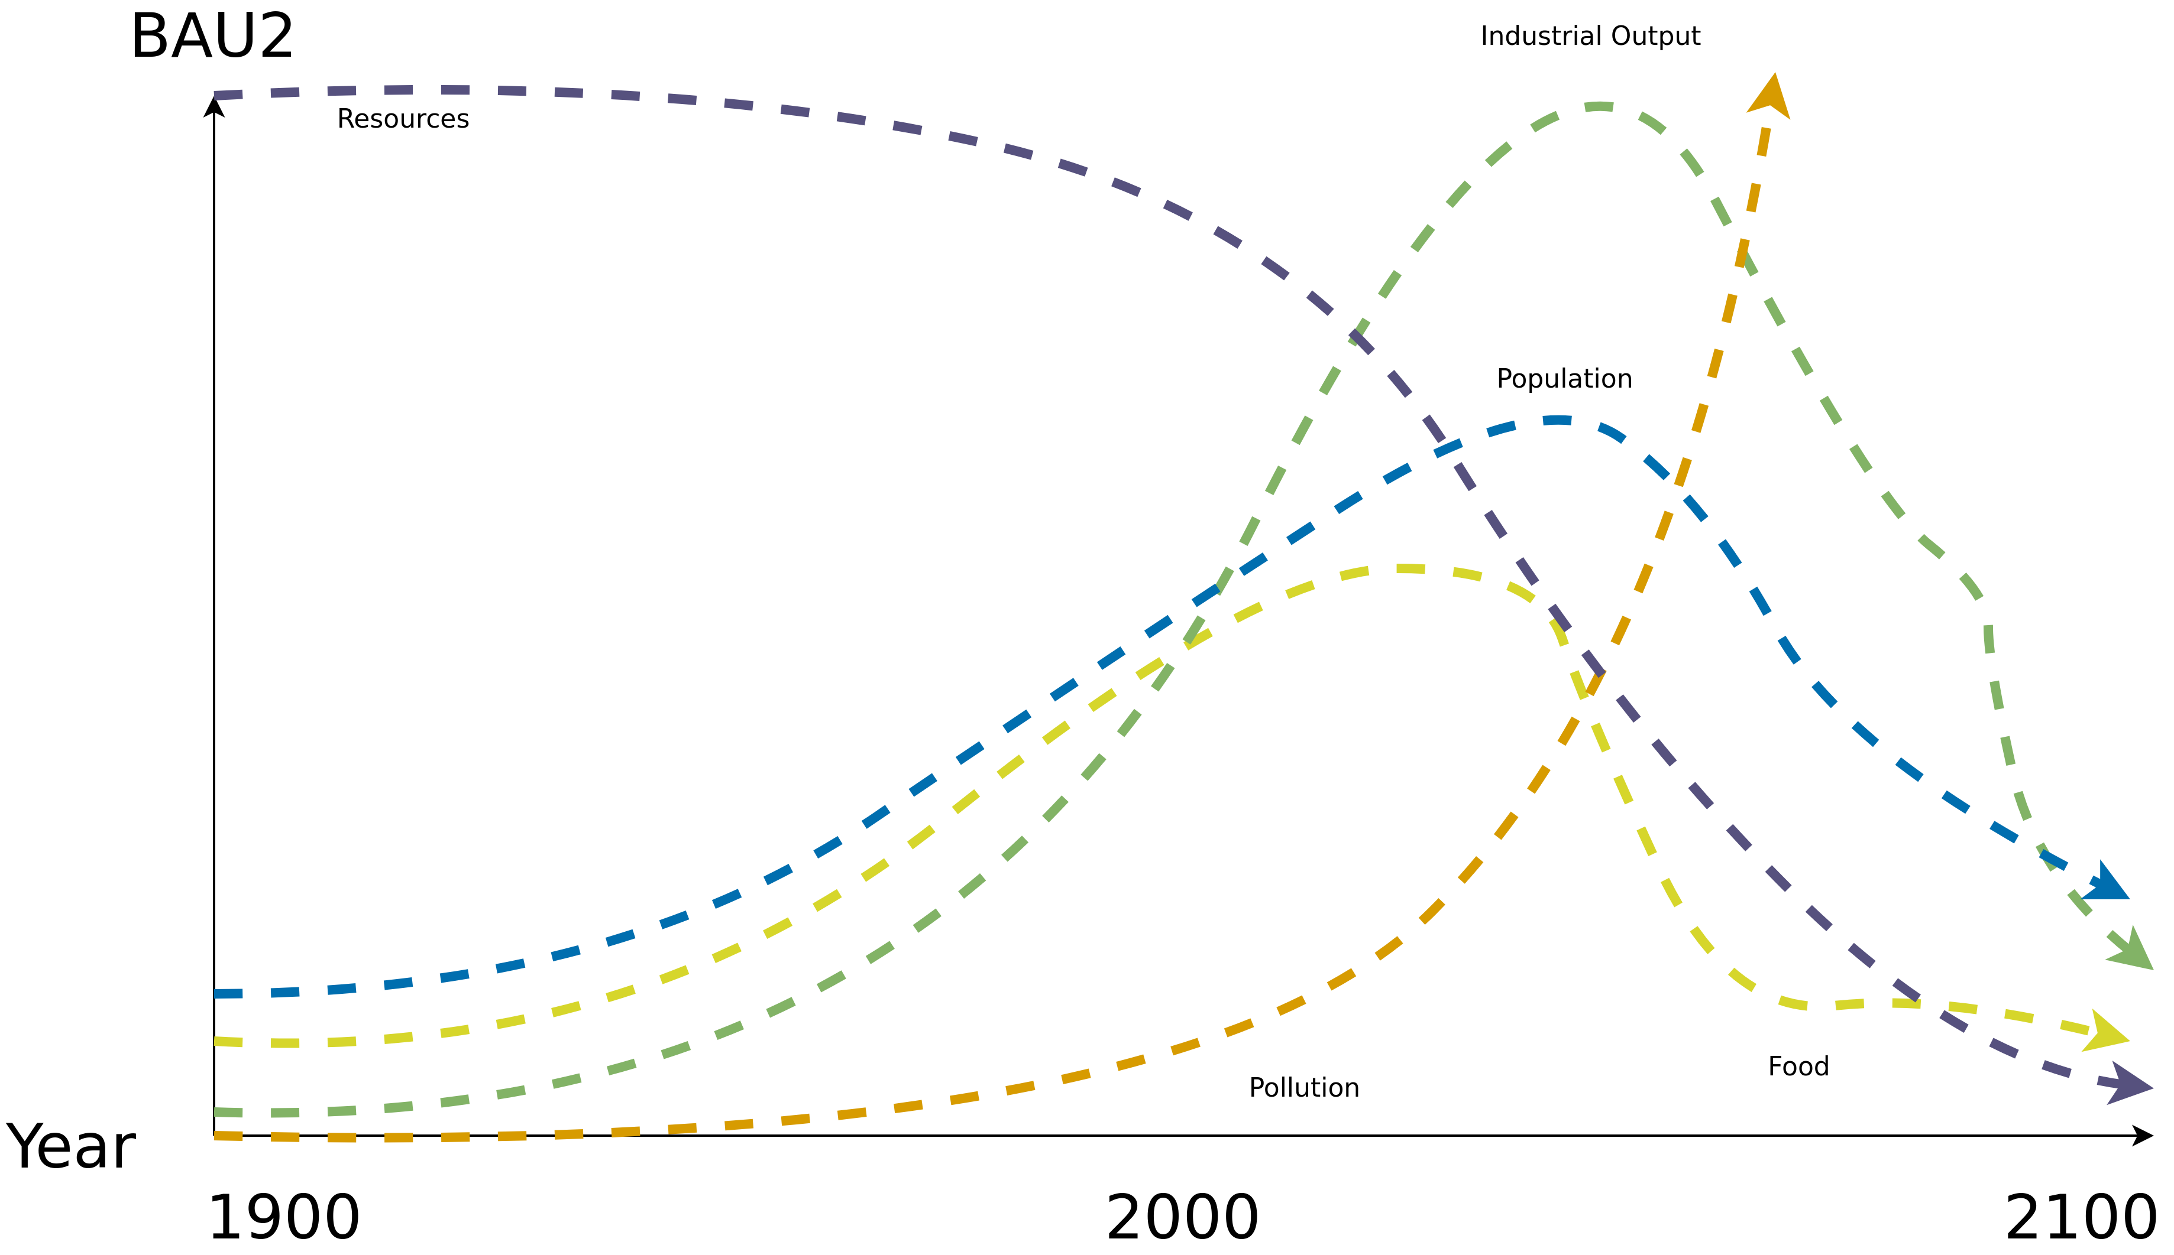
World3
Standard Run – Business-as-Usual2 (BAU2)
Image recreated from: Gaya Herrington (2020) – Update to limits to growth: Comparing the World3 model with empirical data – Link

Slide 38
World3
Standard Run – Business-as-Usual2 (BAU2)
→ Collapse due to pollution (climate change equivalent)
Image recreated from: Gaya Herrington (2020) – Update to limits to growth: Comparing the World3 model with empirical data – Link

Slide 39
World3
Simulation Results
Various scenarios based on different assumptions
4 popular scenarios:
Business-as-usual (BAU)
Business-as-usual2 (BAU2) → double the natural resources of BAU
Comprehensive Technology (CT) → BAU2 + exceptionally high technological development and adoption rates
Stabilized Wolrd (SW) → CT + changes in societal values and priorities

Slide 40
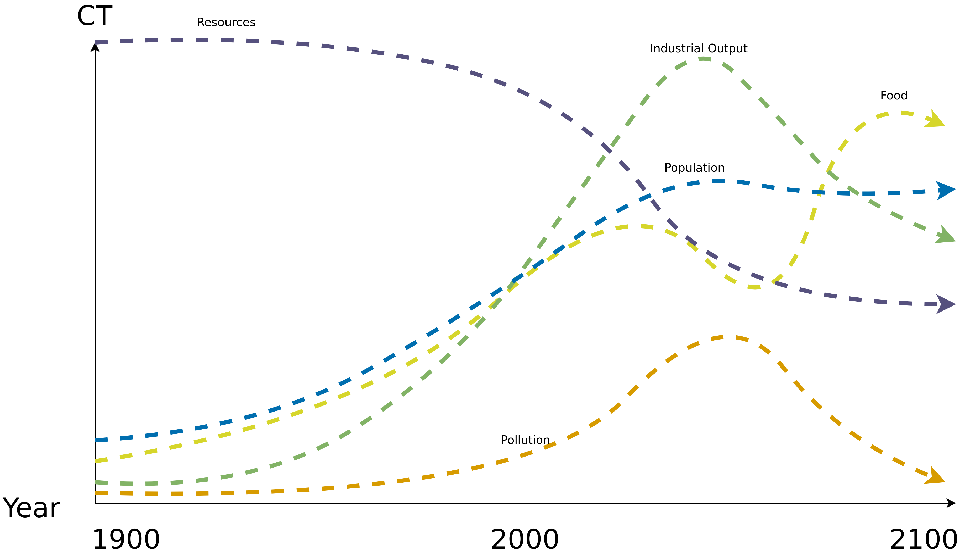
World3
Comprehensive Technology (CT)
Image recreated from: Gaya Herrington (2020) – Update to limits to growth: Comparing the World3 model with empirical data – Link

Slide 41
World3
Comprehensive Technology (CT)
→ Rising costs for technology eventually causes declines, but no collapse
Image recreated from: Gaya Herrington (2020) – Update to limits to growth: Comparing the World3 model with empirical data – Link

Slide 42
World3
Simulation Results
Various scenarios based on different assumptions
4 popular scenarios:
Business-as-usual (BAU)
Business-as-usual2 (BAU2) → double the natural resources of BAU
Comprehensive Technology (CT) → BAU2 + exceptionally high technological development and adoption rates
Stabilized World (SW) → CT + changes in societal values and priorities

Slide 43
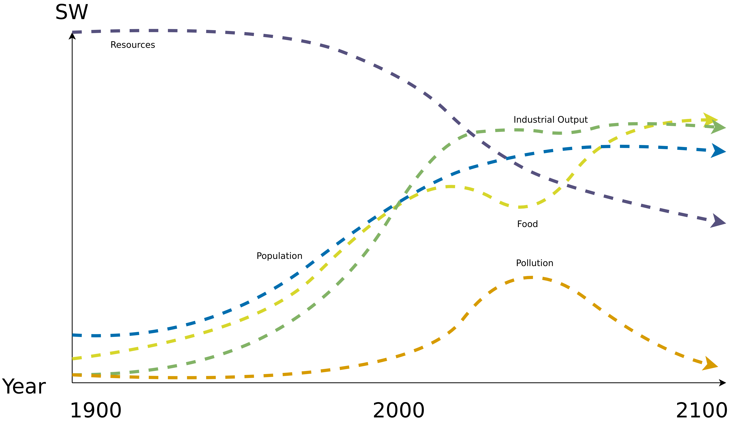
World3
Stabilized World (SW)
Image recreated from: Gaya Herrington (2020) – Update to limits to growth: Comparing the World3 model with empirical data – Link

Slide 44
World3
Stabilized World (SW)
→ Population stabilizes in the twenty-first century, as does human welfare on a high level
Image recreated from: Gaya Herrington (2020) – Update to limits to growth: Comparing the World3 model with empirical data – Link

Slide 45
World3
Simulation Results
Various scenarios based on different assumptions
4 popular scenarios:
Business-as-usual (BAU)
Business-as-usual2 (BAU2) → double the natural resources of BAU
Comprehensive Technology (CT) → BAU2 + exceptionally high technological development and adoption rates
Stabilized Wolrd (SW) → CT + changes in societal values and priorities

Slide 46
World3
Sustainability
World3 indicates that we are already consuming resources at a faster pace than the planet is able to re-grow/generate them
Standard of living is not sustainable
Relieving limiting factors is not a solutions → Instead, it is an accelerator towards disaster
Preventing the worst-case scenario by reducing consumption
F. E. Cellier (2008) – World3 in Modelica: Creating System Dynamics Models in the Modelica Framework – Link

Slide 47
World3
Where are we now?
So which of the 4 scenarios is closest to our current situation?
a) BAU
b) BAU2
c) CT
d) SW

Slide 48
Criticism

Slide 49
Criticism
Model criticized by its creators and others
There is even a complete book dedicated to criticize the model → Models of Doom: A Critique of the Limits to Growth.
Fun fact: Models of Doom is longer than the book it criticizes (Limits to Growth)
1972 book did not contain the equations governing the World3 model
Subsequently released in a further book in 1974 → Dynamics of Growth in a Finite World

Slide 50
Criticism
Heavily criticized by economists → The model questions the fairytale of eternal economic growth
Aggregated variables → one resource, one food, one pollutant, one population
No geographic structure, no social distinctions. "Average food per capita."
Lack of statistical analysis – no error bars
Accused of being too complex and oversimplification
Brian Hayes (2012) – Computation and the Human Condition (Harvard SEAS) – Link

Slide 51
Conclusion

Slide 52
Conclusion
Planetary Boundaries
World3 (1972)→ Modeling the world using System Dynamics
4 commonly used scenarios → BAU, BAU2, CT and SW
SW → Goal
Widespread criticism but the overall message of the World3 model still holds → unsustainable behavior of humans will lead to a collapse of society

Slide 53
Additional Resources
Meadows (1972) – The Limits to Growth.
Meadows, Randers and Meadows (2004) – Limits to Growth – The 30-Year Update.
D. L. Meadows, W. W. Behrens (1974) – Dynamics of Growth in a Finite World.
H. S. D. Cole, Christopher Freeman (1973). Models of Doom: A Critique of the Limits to Growth.
Planetary Boundaries – Stockholm Resilience Center – Link
Planetary Health Check Report 2024. Potsdam Institute for Climate Impact Research – Link
Brian Hayes (2012) – Computation and the Human Condition (Harvard SEAS) – Link

Slide 54
Questions?

